Slide 1
Linear Regression

Slide 2
Linear Regression
It is Supervised Learning Method
Regression
The output variable to be predicted is continuous in nature, e.g. scores of a student, diamond prices, etc.
Classification
The output variable to be predicted is categorical in nature, e.g.classifying incoming emails as spam or ham, Yes or No, True or False, 0 or 1
Linear regression shows the linear relationship between the independent(predictor) variable i.e. X-axis and the dependent(output) variable i.e. Y-axis, called linear regression.

Slide 3
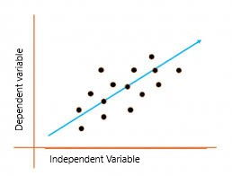
Simple Linear Regression
If there is a single input variable X(dependent variable), such linear regression is called simple linear regression.
The graph presents the linear relationship between the output(y) variable and predictor(X) variables. The blue line is referred to as the best fit straight line.
Y_{i} = β₀ + β₁X_{i}+ε
where Y_{i} = Dependent variable, β₀ = constant/Intercept, β₁ = Slope/Intercept, X_{i} = Independent variable, ε=Residual.

Slide 4
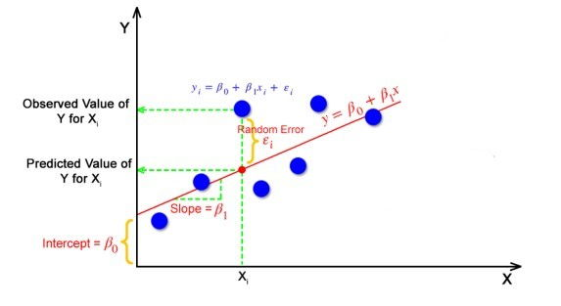
Model

Slide 5
Coefficients and Error
The goal of the linear regression algorithm is to get the best values for B₀ and B₁ to find the best fit line. The best fit line is a line that has the least error which means the error between predicted values and actual values should be minimum.

Slide 6
Random Error(Residuals)
In regression, the difference between the observed value of the dependent variable(y_{i}) and the predicted value(predicted) is called the residuals.
ε_{i} = y_{predicted} – y_{i}
where y_{predicted} = B₀ + B₁ X_{i}

Slide 7
best fit line
The best fit line is a line that fits the given scatter plot in the best way. Mathematically, the best fit line is obtained by minimizing the Residual Sum of Squares(RSS).

Slide 8

Cost Function for Linear Regression
The cost function helps to work out the optimal values for B₀ and B₁, which provides the best fit line for the data points.
In Linear Regression, generally Mean Squared Error (MSE) cost function is used, which is the average of squared error that occurred between the y_{predicted} and y_{i}.

Slide 9
Evaluation Metrics for Linear Regression
The most used metrics are,
Coefficient of Determination or R-Squared (R2)
Root Mean Squared Error (RMSE)

Slide 10
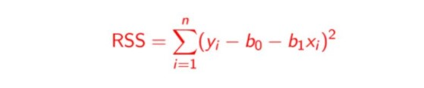
1. Coefficient of Determination or R-Squared (R2)
It always ranges between 0 & 1 .
Overall, the higher the value of R-squared, the better the model fits the data.
Mathematically it can be represented as,
R² = 1 – ( RSS)
Where Residual sum of Squares (RSS)-

Slide 11
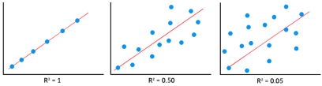
The significance of R-squared

Slide 12

2 Root Mean Squared Error(RMSE)
The Root Mean Squared Error (RMSE) is the square root of the variance of the residuals. It specifies the absolute fit of the model to the data.

Slide 13
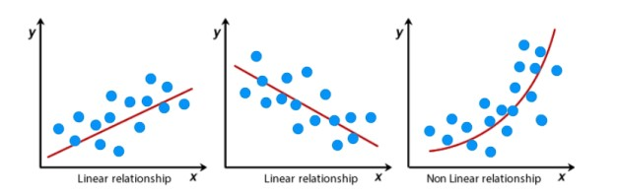
Assumptions of Linear Regression
For successful regression analysis, it’s essential to validate the following assumptions.
1. Linearity of residuals: There needs to be a linear relationship between the dependent variable and independent variable(s).

Slide 14
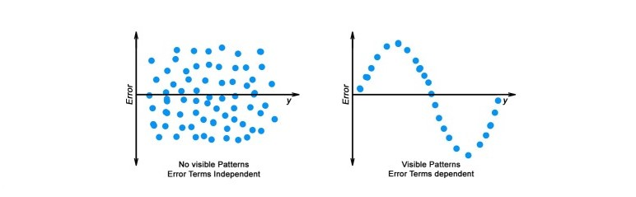
Assumptions of Linear Regression
2. Independence of residuals: The error terms should not be dependent on one another There should be no correlation between the residual terms. The absence of this phenomenon is known as Autocorrelation.
There should not be any visible patterns in the error terms.

Slide 15
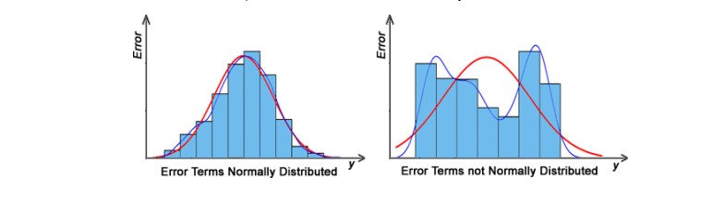
Assumptions of Linear Regression
3. Normal distribution of residuals: The mean of residuals should follow a normal distribution with a mean equal to zero or close to zero.
If the error terms are non-normally distributed, suggests that there are a few unusual data points that must be studied closely to make a better model.

Slide 16
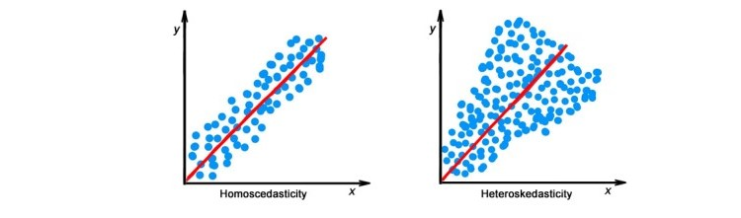
Assumptions of Linear Regression
4. The equal variance of residuals: The error terms must have constant variance. This phenomenon is known as Homoscedasticity.
The presence of non-constant variance in the error terms is referred to as Heteroscedasticity. Generally, non-constant variance arises in the presence of outliers or extreme leverage values.

Slide 17
Multiple Linear Regression
Multiple linear regression is a technique to understand the relationship between a single dependent variable and multiple independent variables.
Y = B₀ + B₁X₁ + B₂X₂ + … + B_{p}X_{p} + ε

Slide 18
Considerations of Multiple Linear Regression
All the four assumptions made for Simple Linear Regression still hold true for Multiple Linear Regression along with a few new additional assumptions.

Slide 19
Overfitting: When more and more variables are added to a model, the model may become far too complex and usually ends up memorizing all the data points in the training set. This phenomenon is known as the overfitting of a model. This usually leads to high training accuracy and very low test accuracy.
Multicollinearity: It is the phenomenon where a model with several independent variables, may have some variables interrelated

Slide 20
Feature Selection: With more variables present, selecting the optimal set of predictors from the pool of given features (many of which might be redundant) becomes an important task for building a relevant and better model.

Slide 21

Multicollinearity
Multicollinearity can be detected using the following methods:
Pairwise Correlations: Checking the pairwise correlations between different pairs of independent variables can throw useful insights in detecting multicollinearity.

Slide 22
Variance Inflation Factor (VIF): VIF explains the relationship of one independent variable with all the other independent variables. VIF is given by,
The common heuristic followed for the VIF values is if VIF > 10 or VIF>20 then the value is definitely high and it should be dropped. And if the VIF=5 then it may be valid but should be inspected first. If VIF < 5, then it is considered a good VIF value.

Slide 23
Overfitting and Underfitting
Bias:
Bias is a measure to determine how accurate is the model likely to be on future unseen data.
Complex models, assuming there is enough training data available, can do predictions accurately. Whereas the models that are too naive, are very likely to perform badly with respect to predictions.
Simply, Bias is errors made by training data.

Slide 24
Overfitting and Underfitting
Variance:
Variance is the sensitivity of the model towards training data, that is it quantifies how much the model will react when input data is changed.
Ideally, a model should have lower variance which means that the model doesn’t change drastically after changing the training .
Having higher variance will make a model change drastically even on a small change in the training dataset.

Slide 25
Bias Variance Tradeoff
The aim of any supervised machine learning algorithm is to achieve low bias and low variance as it is more robust. So that the algorithm should achieve better performance.
There is an inverse relationship between bias and variance,
An increase in bias will decrease the variance.
An increase in the variance will decrease the bias.

Slide 26
Overfitting
When a model learns each and every pattern and noise in the data to such extent that it affects the performance of the model on the unseen future dataset, it is referred to as overfitting.
When a model has low bias and higher variance it ends up memorizing the data and causing overfitting.
Detecting overfitting is useful, but it doesn’t solve the actual problem.
There are several ways to prevent overfitting, which are stated below:
Cross-validation
If the training data is too small to train add more relevant and clean data.
If the training data is too large, do some feature selection and remove unnecessary features.
Regularization

Slide 27
Underfitting:
When the model fails to learn from the training dataset and is also not able to generalize the test dataset, is referred to as underfitting.
When a model has high bias and low variance it ends up not generalizing the data and causing underfitting. It is unable to find the hidden underlying patterns from the data. This usually leads to low training accuracy and very low test accuracy.
The ways to prevent underfitting are stated below,
Increase the model complexity
Increase the number of features in the training data
Remove noise from the data.

Slide 28
Thank you!!!

